Slide 1

Half Adder & Full Adder
Digital Logic Design with Logisim

Slide 2
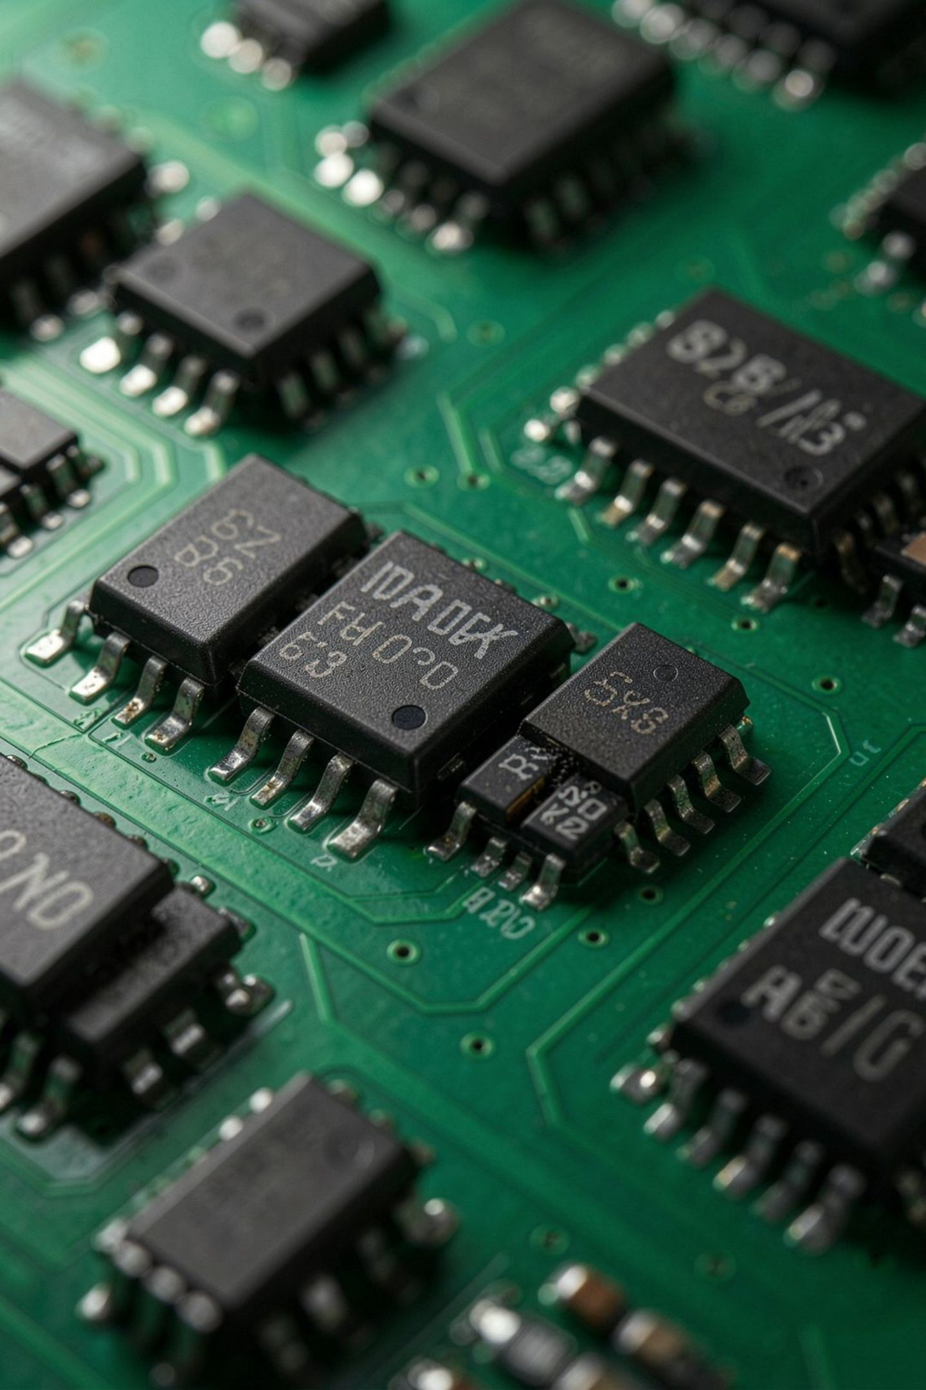
What Are Adders?
Adders are combinational digital circuits that perform binary addition — the foundation of all arithmetic in computing.
Half Adder
Full Adder
Adds two 1-bit binary numbers, producing a Sum and a Carry output.
Adds three 1-bit inputs — including a carry-in from a previous stage — enabling multi-bit arithmetic.
Logisim
Both circuits can be designed and tested interactively using the Logisim simulation environment.

Slide 3
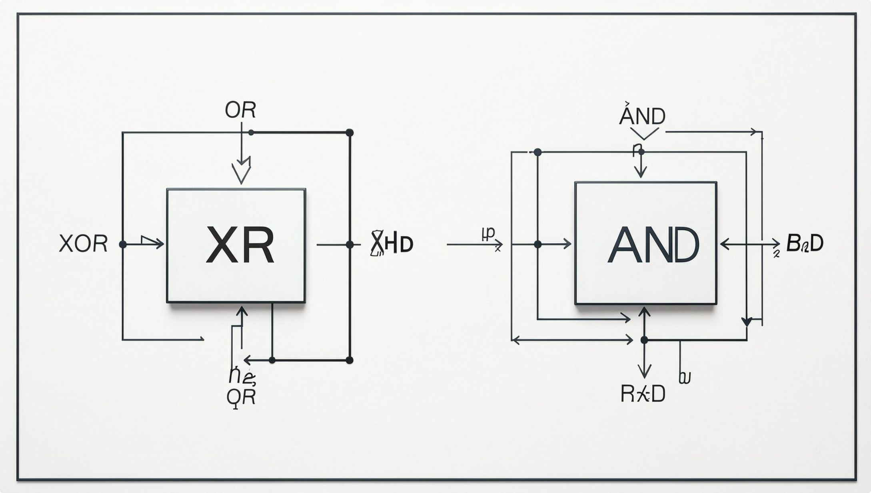
Half Adder Basics
The Half Adder is the simplest binary addition circuit, operating on just two 1-bit inputs.
Inputs
Outputs
Logic Expressions
Components
A and B — two 1-bit binary numbers
Sum (S) and Carry (C)
Sum = A XOR B
Carry = A AND B
1 XOR gate + 1 AND gate

Slide 4

Half Adder Truth Table
When both inputs are 1, the result is binary 10: Sum = 0 and Carry = 1.
A | B | Sum (S) | Carry (C)
0 | 0 | 0 | 0
0 | 1 | 1 | 0
1 | 0 | 1 | 0
1 | 1 | 0 | 1
Key Insight
The Half Adder correctly handles all four possible input combinations for two binary digits.
1 + 1 in binary = 10 — the Sum stays 0 and the overflow is captured as Carry = 1.
The XOR gate computes the Sum, while the AND gate detects when both bits are 1, generating the Carry.

Slide 5
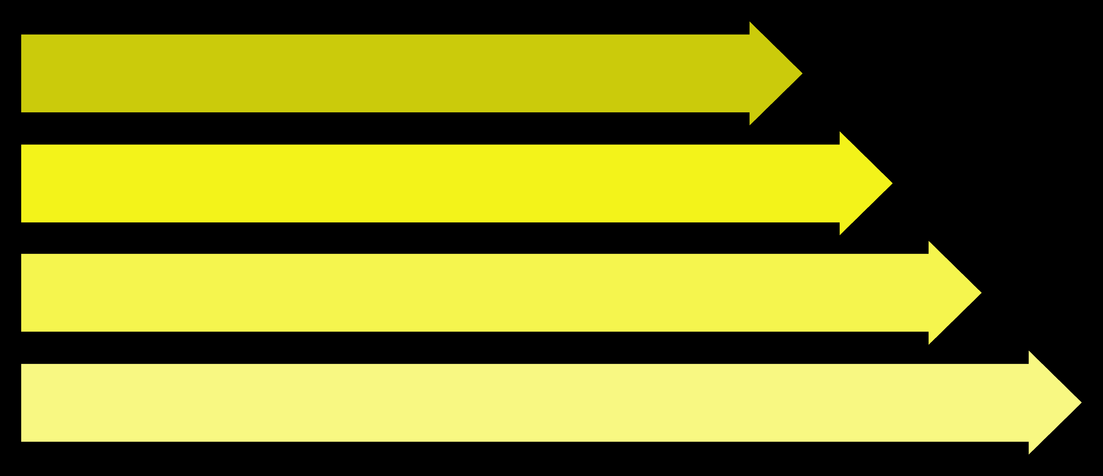
Building a Half Adder in Logisim
Follow these six steps to construct and verify your Half Adder circuit:
Place Inputs
Wire XOR
Set Sum
Wire AND
After wiring, toggle A and B through all four combinations (00, 01, 10, 11) to verify outputs match the truth table.

Slide 6

Full Adder Basics
The Full Adder extends the Half Adder by accepting a carry-in (Cin) from a previous addition stage — making multi-bit addition possible.
Inputs
A, B, and Cin (carry from previous stage)
Outputs
Sum and Cout (carry output to next stage)
Sum Logic
Sum = A XOR B XOR Cin
Carry Logic
Cout = AB + Cin(A XOR B)

Slide 7
Full Adder Truth Table
All 8 possible input combinations for A, B, and Cin — with resulting Sum and Cout:
A | B | Cin | Sum | Cout
0 | 0 | 0 | 0 | 0
0 | 0 | 1 | 1 | 0
0 | 1 | 0 | 1 | 0
0 | 1 | 1 | 0 | 1
1 | 0 | 0 | 1 | 0
1 | 0 | 1 | 0 | 1
1 | 1 | 0 | 0 | 1
1 | 1 | 1 | 1 | 1

Slide 8

Building a Full Adder in Logisim
A Full Adder can be elegantly built using two Half Adders and one OR gate — a beautifully modular design.
Half Adder 1
Half Adder 1
Inputs A and B produce S1 and C1
1
A + B → produces intermediate Sum S1 and Carry C1
Half Adder 2
2
S1 + Cin → produces the final Sum and Carry C2
Three-component Full Adder
OR Gate
3
C1 OR C2 → produces the final Cout to the next stage
OR Gate
Half Adder 2
Combines C1 and C2 to produce Cout
Inputs S1 and Cin produce Sum and C2
This modular approach makes the circuit intuitive to understand and easy to test.

Slide 9
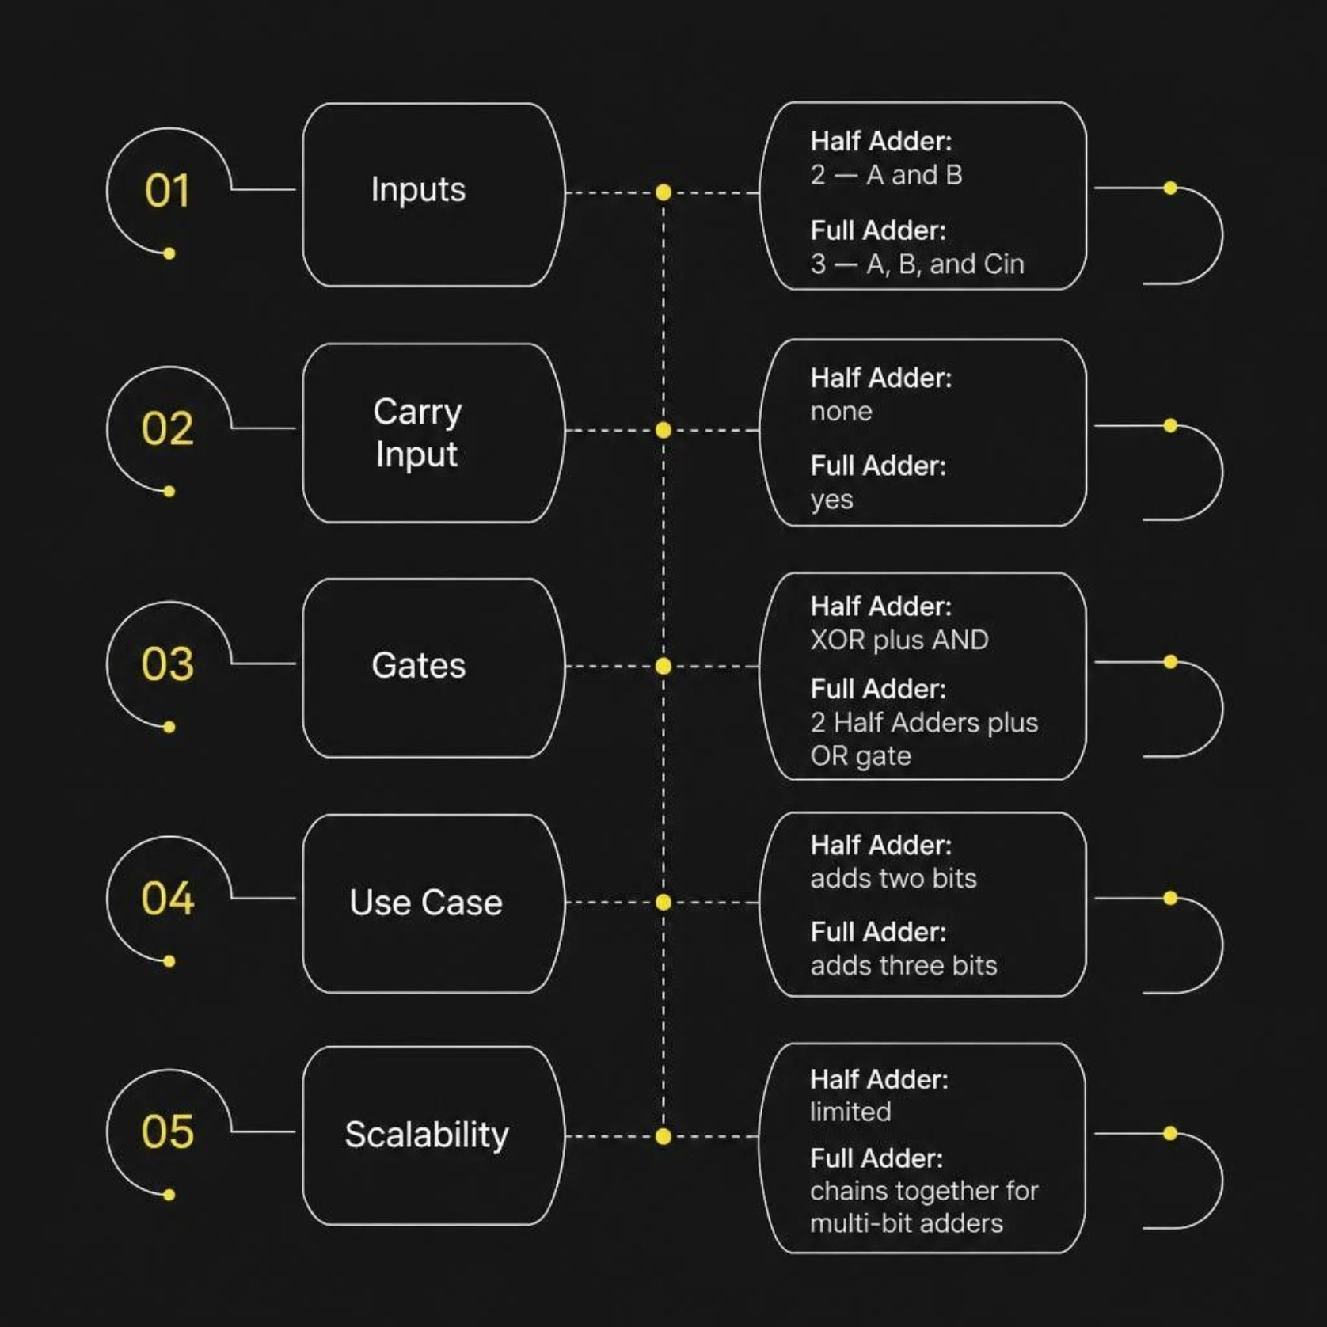

Half Adder vs Full Adder
Which One to Use?
Use a Half Adder when adding just two single bits with no carry-in — ideal for the least significant bit position.
Use a Full Adder for every subsequent bit position in a multi-bit number, where a carry-in from the previous stage must be accounted for.
Full Adders chain together to build 4-bit, 8-bit, and wider binary adders — the backbone of every CPU's Arithmetic Logic Unit.

Slide 10

Real-World Applications
Adder circuits are everywhere — from pocket calculators to billion-transistor processors.
Binary Arithmetic
Core operation in all digital systems performing numeric computation.
ALUs in Processors
Arithmetic Logic Units rely on adder chains to execute every addition instruction.
Microcontrollers
Embedded systems use adders for sensor data processing and control logic.
Multi-bit Adders
Full Adders chained in ripple-carry or carry-lookahead configurations enable wide integer arithmetic.

Slide 11
Key Takeaways & Conclusion
Half Adders and Full Adders are more than just theoretical concepts; they are the fundamental building blocks powering modern digital computation.
1
2
3
Fundamental Blocks
Core of Arithmetic
Ubiquitous in Systems
Both Half and Full Adders are essential combinational circuits for implementing binary addition, laying the groundwork for complex logic.
Full Adders, by handling carry-in, enable the creation of multi-bit adders, which are critical for all arithmetic operations in CPUs.
From microcontrollers to advanced processors, these adder circuits are integral components, demonstrating the power of modular digital design.

